Slide 1

Task 2
Predicting customer buying behaviour

Slide 2
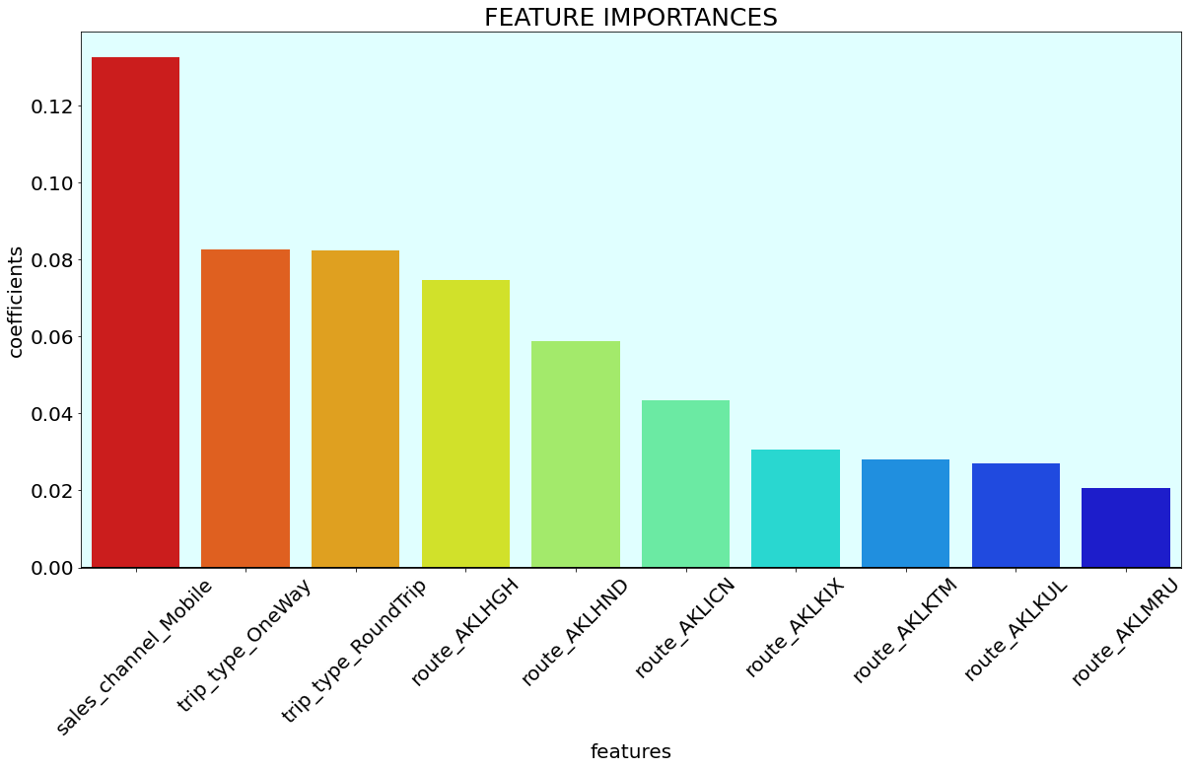
We have gathered data related to customers purchasing the flights ticket and trained the model the predict purchasing behaviour of the customers with the accuracy of 89.96% and f1 score of 90% respectively.
From the feature importance graph we can see that:
1. Sales_channel_mobile is the most
influential factor which was originally
derived from the feature sales_channel
2. Second most influential factor is
trip_type_OneWay which was
originally derived from the feature
trip_type.
3. Third most influential factor is
trip_type_RoundTrip which was
originally derived from the feature
trip_type.
4. The rest of the factors in importance feature graph are derived from the route
variable.
Hence, sales_channel, trip_type and
route are the top 3 influential factor
of the model.

